Slide 1
Lead prediction for LearnTech solutions
Presented by
Rebbufred RJ

Slide 2






Excel CSV format
Data Sources Used
Summary of analysis
Top 3 recommendations
01
02
03
04
05
06
Business Task
Documentation
Visualizations
To improve the lead conversion rate for a leading Ed Tech company

Slide 3
Cleaning and manipulation of data
Handling empty cells
Measures for lead conversion
Specialization analysis
Geographical analysis
Handled empty cells in Lead source, specialization, employment, tags, lead quality.
Created a measure that derives the values from the lead related fields.
Created a bar and pie chart and analyzed the trends of a particular field. The cell formatting helped.
Created a map visualization that helps in getting geographic insights on various countries.. Added a filter on the country visual so that we can drill down into each country

Slide 4
Summary of the analysis
Lead source analysis
Lead Origin analysis
Specialization analysis
Percentage Contribution
Even though the Google has highest converted leads, the reference has highest conversion rate
Financial management and marketing management tops the chart
Analyzed the landing page lead with respect to the conversion rate and gained insights
Healthcare management and Banking, Insurance and Investment has 50% conversion rate.

Slide 5
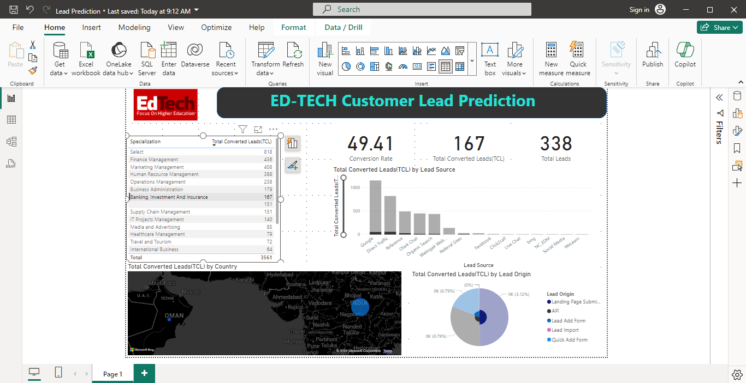
Visualization (through PowerBI)

Slide 6
Top 3 recommendations
Focus towards Reference field
Geographic segmentation
Focusing on CSR
Even though reference is in 3rd place in the total converted leads, the conversion rate is nearly 92%. So, increasing numbers towards this leads to better total lead conversion
By including courses that caters the sustainability of the environment would result in increase in reference based leads
By increasing the targeted ads to the consumers that are outside India would result in more lead conversion

Slide 7
THANK YOU

